Slide 1
CNS LAB PROJECT
SQL INJECTION AND PREVENTION
USING PARAMETERISED SQL TECHNIQUE
TEAM-:
ANMOL CHADHA (2021UCP1325)
LOCHAN JAIN (2021UCP1322)

Slide 2
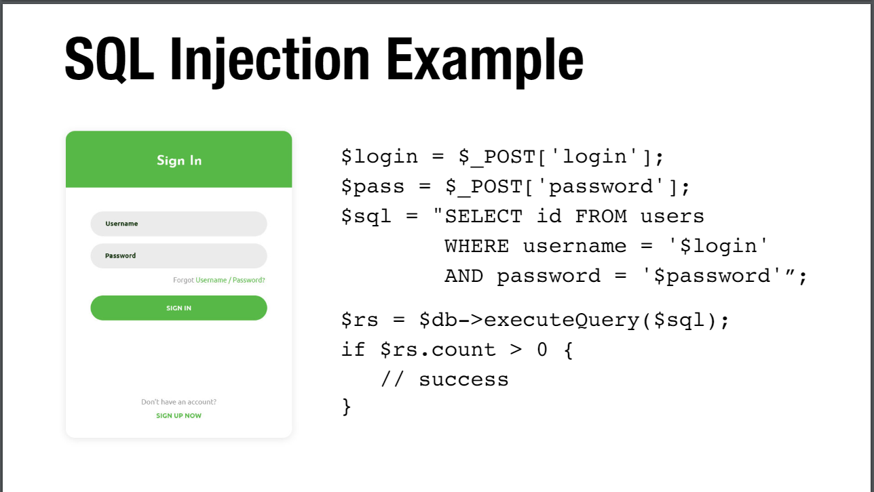

Slide 3
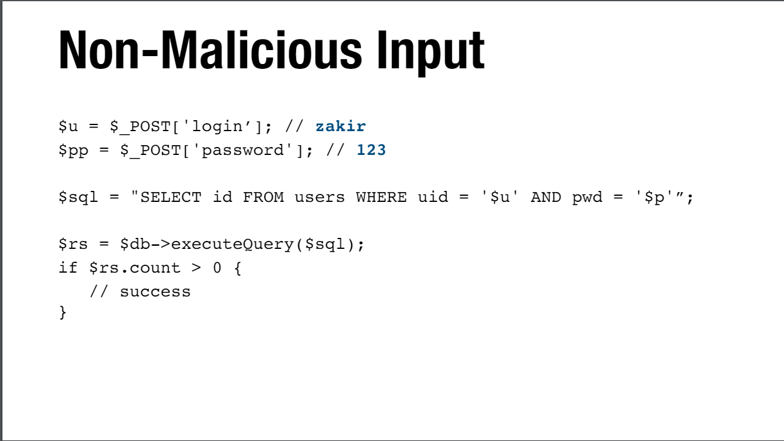

Slide 4
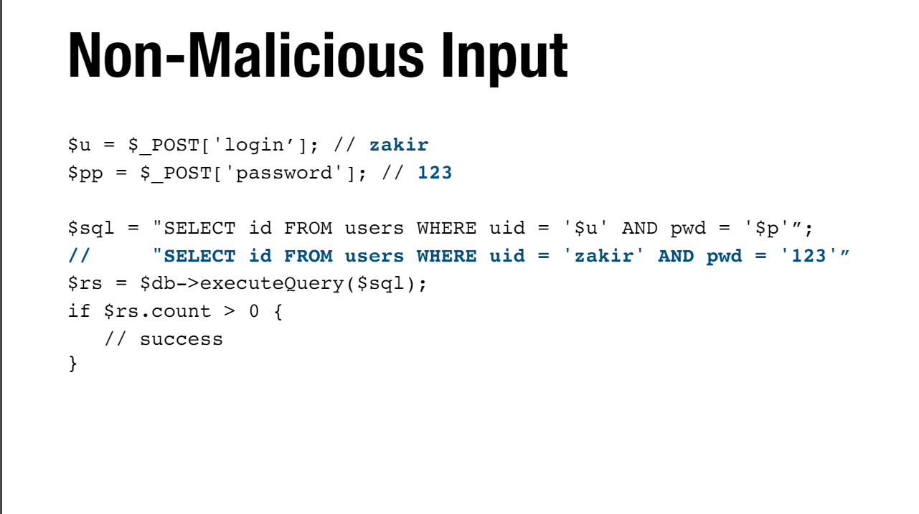

Slide 5
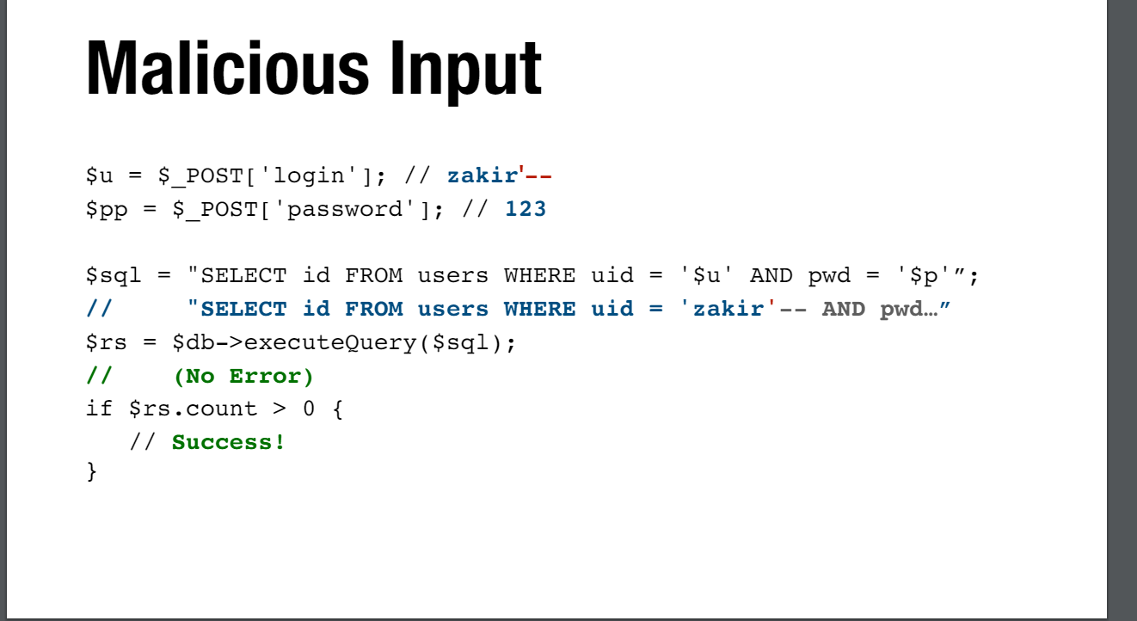

Slide 6
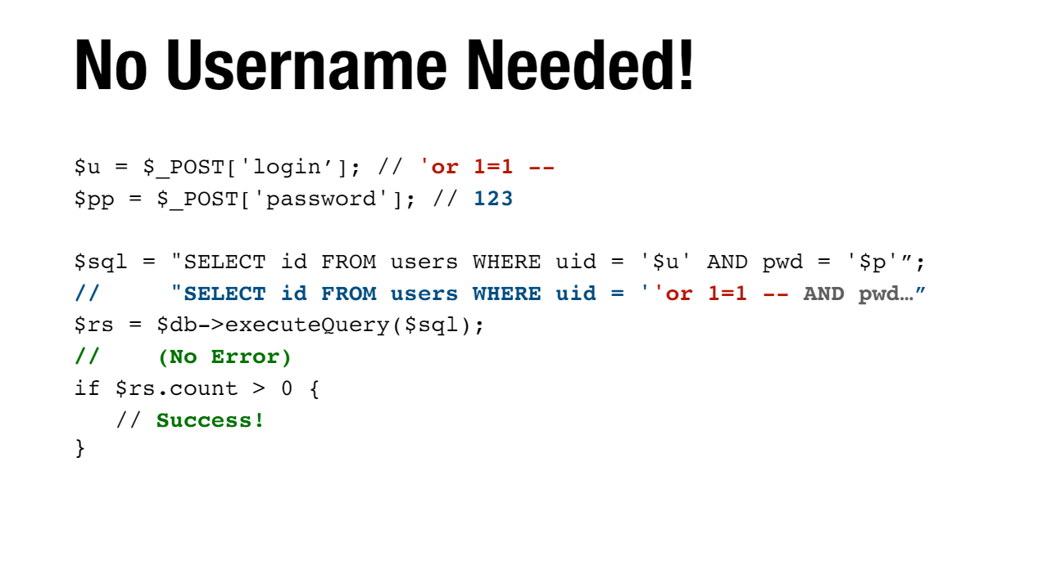

Slide 7
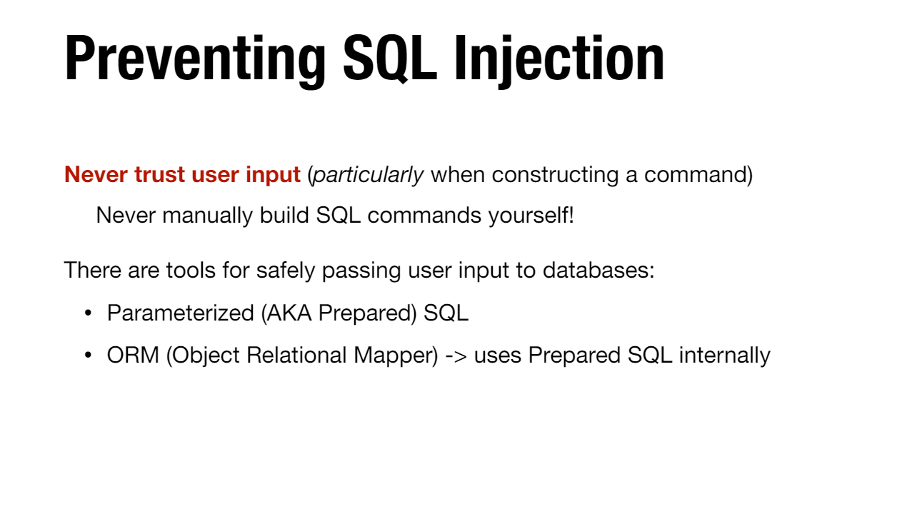

Slide 8
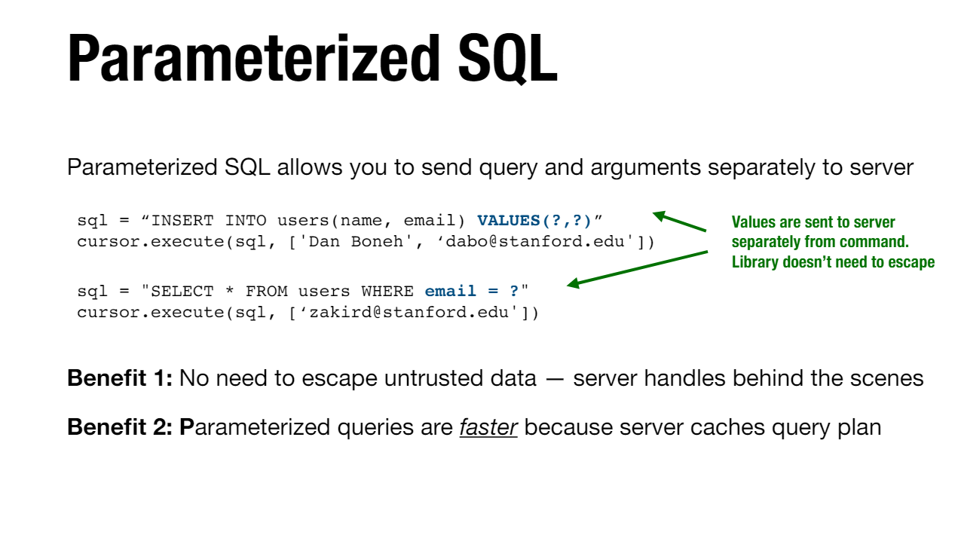

Slide 9
CODE FOR PARAMETERISED
import sqlite3
# Connect to the SQLite database
conn = sqlite3.connect('example.db')
cursor = conn.cursor()
# Create a table if it doesn't exist
cursor.execute('''CREATE TABLE IF NOT EXISTS users ( id INTEGER PRIMARY KEY,username TEXT,password TEXT)''')

Slide 10
# Function to insert a new user into the database
def add_user(username, password):
try:
# Use a parameterized query to avoid SQL injection
cursor.execute("INSERT INTO users (username, password) VALUES(?, ?)", (username, password))
conn.commit()
print("User added successfully")
except sqlite3.Error as e:
print("Error adding user:", e)
# Function to retrieve a user from the database

Slide 11
def get_user(username):
try:
cursor.execute("SELECT * FROM users WHERE username=?", (username,))
user = cursor.fetchone()
if user:
print("User found:", user)
else:
print("User not found")
except sqlite3.Error as e:
print("Error retrieving user:", e)

Slide 12
# Example usage
add_user("john_doe", "password123")
get_user("john_doe")
# Close the connection
conn.close()

Slide 13
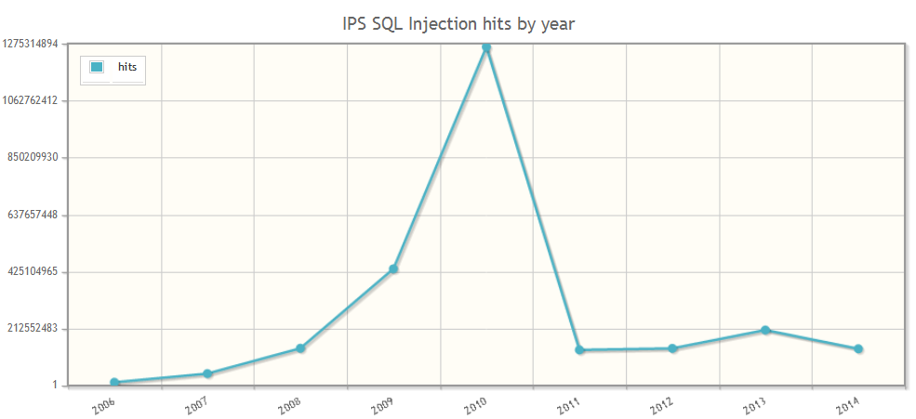

Slide 14
SQL Injection is old but still functional
Sql injection is still used widely on ignorant websites.
Some developers still ignore sql prevention techniques because they are not widely discussed now but are able to destroy the system databases.
Parameterized eliminates the sql injections and provide a system free from attacks.

Slide 15
THANK YOU

